Slide 1
Machine Learning Intermediate: “spam” Dataset
Lets ANALYSE and Create the MODEl to predict SMS as ham/spam from SPAM data

Slide 2
What we are analyzing and achieving
We are analyzing the data within the spam-dataset through different preprocessing technique like: shape, info, description etc.
We see data through different graphs like: histogram to see how data is behaving and if larger messages(length of data) are trending towards being spam.
We will use bag-of-words technique to convert our text format (strings) data to numerical feature vector in order to perform the classification task.
We will clean data after analysis as well as standardize the same to provide weightage accordingly.
We will try to create model to eventually predict the class of message i.e. ham/spam.

Slide 3

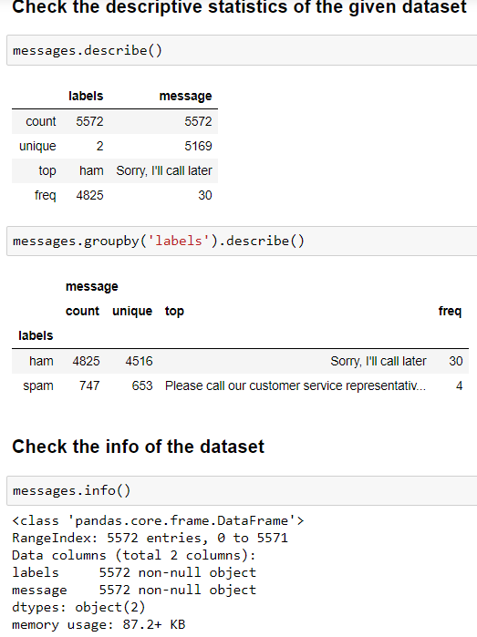
Data Analysis
We have total number of 5572 messages as research dataset.
We have ham/spam as 2 labels(classes) against messages data and 5169 unique messages.
Ham category messages are 4825 and one message has higher frequency as 30.
We have certainly duplicate messages as unique < count.
We don’t have any null valued data within the dataset.

Slide 4
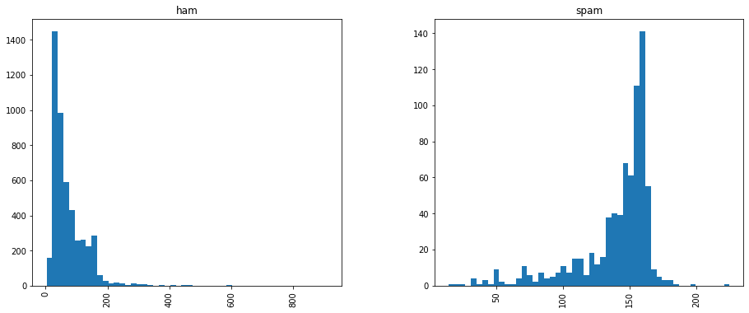
Data Visualization
As we have text messages and we need to visualize more to make a decision in message category, we create new column as “length”.
Plotting histogram against the column length, we see something which was not visible through text that length of the spam messages are usually high(mostly 130+) compared to legitimate messages.
They are trying to convince us anyhow ☺.

Slide 5
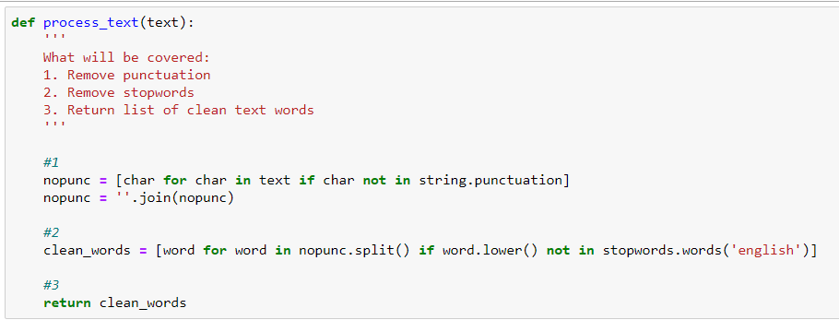
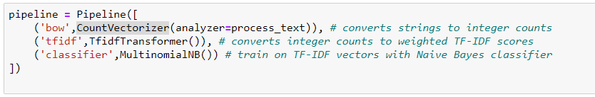
Model Prediction and Evaluation-1
We have data in text format only so we need to convert this to some kind of numerical feature vector so that our classification algo. can use the same.
We will use bag-of-words approach to achieve the same.
We will convert string into list of words excluding punctuation and stopwords.
Then we will apply vectorization, TF-IDF and finally Naïve Bayes multinomial classifier.

Slide 6
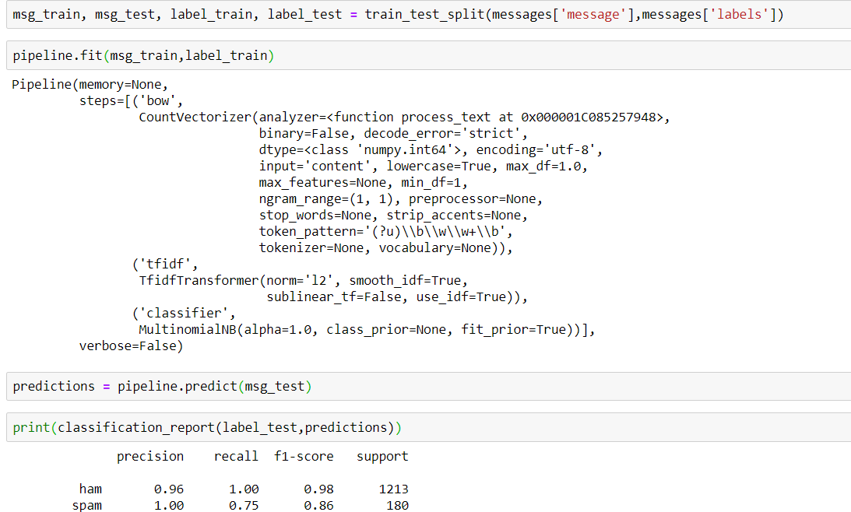
Model Prediction and Evaluation-2
Now we split test, train data to find finally predict with test data.
We see that results are fairly good as we see recall and f1-score are high enough.
We can predict if message is ham/spam with this much accuracy.

Slide 7
Analysis and Observation
We have applied bag-of-words approach to convert text format to be usable for NB classifier.
After evaluation through Classification report, we can fairly say that messages can be classified into ham/spam with good accuracy.
We can certainly achieve more fair accuracy with more data input to the model.

